Slide 1
Demand & Supply
Concept of Elasticity

Slide 2
In this unit
Consumer’s Optimal Demand
Market Demand, Supply and Equilibrium
Different Types of Elasticities
Estimating Demand Functions
Use of Elasticities
Forecasting Demand

Slide 3

Let’s Think……….
Why do buyers of some products (eg, holiday trip) respond to price increases by substantially reducing their purchases while buyers of other products (say, gasoline) respond by only slightly cutting back their purchases?
Why do lower market prices for some products (eg, chicken) cause consumers to greatly increase their output while price fall for other products (say, rice) cause only limited increases in output?
Why does the demand for some products (eg, books) rise a great deal when household income increases while the demand for other products (say, milk) rises just a little?
Why do different consumers pay different prices for same product?

Slide 4

This Chapter……….
It extends our understanding of markets by letting us know the degree to which changes in prices and incomes affect supply and demand.
Sometimes the responses are substantial, other times minimal or even nonexistent.
By being able knowing what to expect, businesses and the government can do a better job in deciding what to produce, how much to charge, and, surprisingly, what items to tax.

Slide 5

As a Manager - How can we make a market - the Seller’s market?

Slide 6

What elements managers can control to influence demand of his/her product?
Price
Advertising
Product Quality
Distribution Strategies

Slide 7

What elements managers cannot control but need to KNOW???
Availability of Substitutes
Interest Rates
Pricing & Advertisements of Competitors
Taxes
Local & Global Economic Activities

Slide 8
Role of a Manager
Understand the nature of product
manage demand to increase/decrease sales
discover demand to forecast its value
discover demand to see how it should be managed in response to changes in competitor’s prices etc.

Slide 9

Elasticity of Demand
Elasticity of Demand measures the responsiveness of the quantity demanded of a good, to the change in any of its determinants such as its price, price of other goods, changes in consumer’s income, advertisement expenditure etc.

Slide 10

How can the concept of Elasticity be useful to managers?
the sensitivity of demand to its price helps in pricing strategies
the sensitivity of demand to its income helps in pricing strategies
the sensitivity of demand to its advertisement helps in increasing sales

Slide 11

Price Elasticity of Demand (PED)
A measure of the responsiveness of quantity demanded to changes in price.
%Δ P → %Δ Q

Slide 12
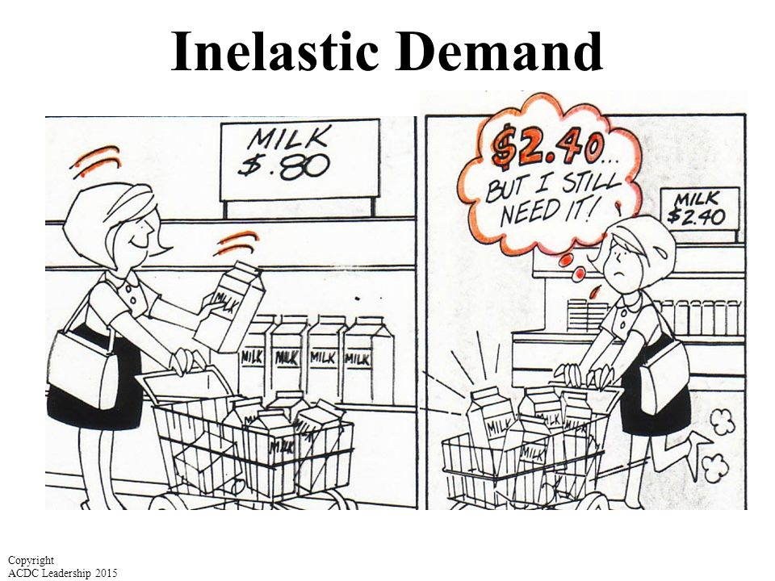
Let’s Observe - SITUATION #1

Slide 13
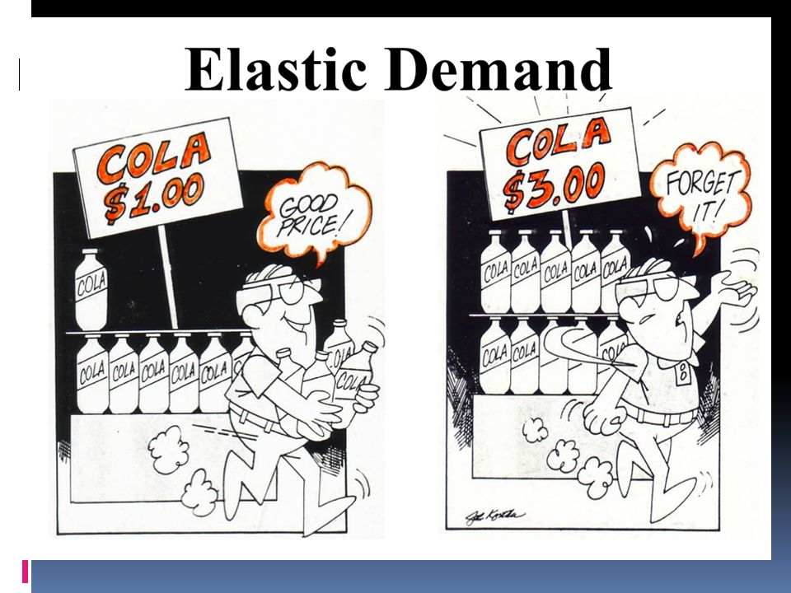
Let’s Observe - SITUATION #2

Slide 14
SITUATION #1
Price having lesser effect on Demand

Slide 15
SITUATION #2
Price having greater effect on Demand

Slide 16

Price Elastic Vs Price Inelastic
Price Elastic – when change in price has greater effect on demand
Price Inelastic – when change in price has lesser effect on demand

Slide 17
What factors cause a consumers to be sensitive to its price?

Slide 18
Factors affecting Price Elasticity of Demand
Availability of close substitute
Consumer’s loyalty/ Habits
Necessities versus luxuries
Proportion of income spent on the product
Postponement of the Use
Time
Goods having several uses
Joint Demand
Income of the consumer

Slide 19






Factors affecting Price Elasticity of Demand
Availability of close substitute

Slide 20




Factors affecting Price Elasticity of Demand
Consumer’s loyalty/ Habits

Slide 21




Factors affecting Price Elasticity of Demand
Necessities versus luxuries

Slide 22


Factors affecting Price Elasticity of Demand
Proportion of income spent on the product

Slide 23




Factors affecting Price Elasticity of Demand
Postponement of the Use

Slide 24


Factors affecting Price Elasticity of Demand
Time

Slide 25
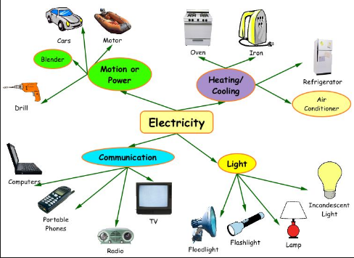
Factors affecting Price Elasticity of Demand
Goods having several uses

Slide 26

Factors affecting Price Elasticity of Demand
Joint Demand

Slide 27



Factors affecting Price Elasticity of Demand
Income of the consumer

Slide 28
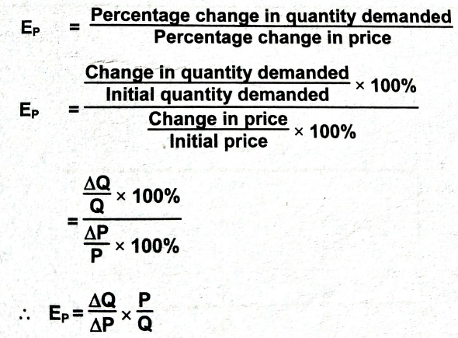
Elasticity of Demand
Percentage Method
Proportionate Method
The absolute value of the coefficient of elasticity of demand ranges from zero to infinity
Where,
E_{P} = Price Elasticity of Demand
Q = Initial Quantity Demanded
∆Q = Change in Quantity Demanded (Q₁ - Q)
P = Initial Price
∆P = Change in Price (P₁ - P)

Slide 29
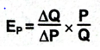
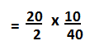
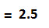
Elasticity of Demand - Implications
Given
Initial Price (P) = Rs.10 Initial Quantity (Q) = 40
New Price (P1) = Rs. 8 New Quantity (Q1) = 60
∆ P = P₁ - P
∆ Q = Q₁ - Q
= 8 - 10
= 60 - 40
= - 2
= 20
We Know
Interpretation: Here since E_{P} > 1, the demand is elastic.
It means that when there is 1% increase in the Price of the product, the quantity demanded falls by 2.5%

Slide 30
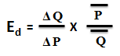
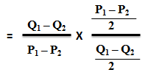
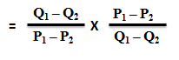
Calculating Elasticity of Demand with when changes in prices/quantities are large
Arc Method

Slide 31
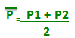
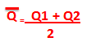
Given : Q = 6,000,000 – 1,000,000P
P₁ = 2
P₂ = 30
Find PED with Arc Method
When P₁ = 2,
Q₁ = 6,000,000 – 1,000,000 (2)
= 4,000,000
When P₂ = 30
Q₂ = 6,000,000 – 1,000,000 (30)
= 30,000,000
∆ P = P₂ – P₁ = 30-2 = 28
∆ Q = Q₂ – Q₁
= 30,000,000 – 4,000,000
= 26,000,000
= 16
=0.87
Interpretation: Here since E_{P} < 1, the demand is relatively inelastic. It means that when there is 1% increase in the Price of the product, the quantity demanded falls by 0.87 % and vice versa.
= 17,000,000

Slide 32
Using Simple Derivative for ED
It deals with the process of finding the rate at which a variable is changing.
For example, the change in the quantity demanded of a commodity is related to the change in its price; D = f(P)
Differentiation is the process of finding the rate at which demand is changing due to the change in price.

Slide 33
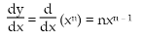
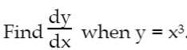
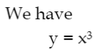
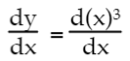
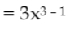
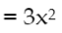
Rule #1 for Differentiation
Power Rule

Slide 34
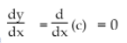
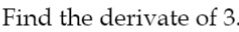
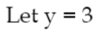
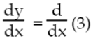
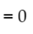
Example of Rule #2 for Differentiation
2. Differentiation of a Constant

Slide 35
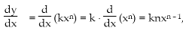
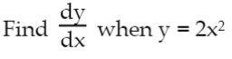
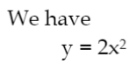
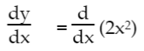
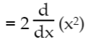
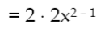
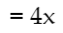
Example of Rule #3 for Differentiation
3. Constant Multiple Rule

Slide 36
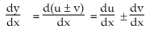
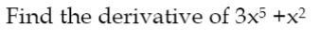
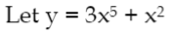
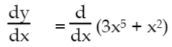
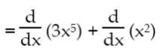
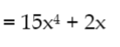
Example of Rule #4 for Differentiation
4. Sum-Difference Rule

Slide 37
If P = $300
Q = 300,000
dQ ₌ -2000
dP
₌ -2000 _{x} 300 .
300000
= -2
Here PED = - 2 ---- What does it mean???

Slide 38
Measurement of PED - Five Coefficients
Perfectly Inelastic Demand (e_{D} = 0)
Inelastic/Less than Unit Elastic Demand(e_{D} < 1)
Unitary Elastic Demand (e_{D} = 1)
Elastic /More than Unit Elastic Demand (e_{D} > 1)
Perfectly Elastic Demand (e_{D} = ∞)

Slide 39
Measurement of PED - Five Coefficients
Perfectly Inelastic Demand (e_{D} = 0)
Quantity demanded does not change as price changes.
Price
D
P2
Medicine
10%
P1
Emergency Services
Very Essential Food Items
O
Q
Quantity Demanded

Slide 40
Measurement of PED - Five Coefficients
2. Inelastic/Less than Unit Elastic Demand(e_{D} < 1)
The percentage change in quantity demanded is less than the percentage change in price.
Price
D
P2
10%
Salt
P1
Chocolates
4%
Kerosene
O
Q2
Q1
Quantity Demanded

Slide 41
Measurement of PED - Five Coefficients
3. Unitary Elastic Demand (e_{D} = 1)
The percentage change in quantity demanded is equal to the percentage change in price.
Price
D
P2
10%
Comfort Goods - good which isn’t necessary but gives enjoyment
P1
10%
Netflix
O
Q2
Q1
Take Away Food
Quantity Demanded

Slide 42
Measurement of PED - Five Coefficients
4. Elastic /More than Unit Elastic Demand (e_{D} > 1)
The percentage change in quantity demanded is greater than the %age change in price.
Price
D
P2
10%
Luxury Goods
P1
AC
18%
Costly Furniture
O
Q2
Q1
Quantity Demanded

Slide 43
Measurement of PED - Five Coefficients
5. Perfectly Elastic Demand (e_{D} = ∞)
A small percentage change in price causes an extremely large percentage (infinite) change in quantity demanded (from buying all to buying nothing).
Price
D
P
Luxury Goods or Goods that take large share of Income
Very Expensive Holiday Packages
O
Very Expensive Sports Cars
Quantity Demanded

Slide 44
How can a manager use the concept of Price elasticity of Demand to his/her benefit?
Price Determination
Price Discrimination
Wage Discrimination

Slide 45
Chevrolet and Honda cater to the subcompact segment of the automobile market with their Chevette and Civic models, respectively. A consistent way of comparing the price sensitivity of Chevette vis-a-vis Civic buyers is to use price elasticity of demand.
The price elasticity of demand for Chevette and Civics have been estimated to be -3.2 and -3.4.
As a manager of Chevette what do you understand about Civic?

Slide 46
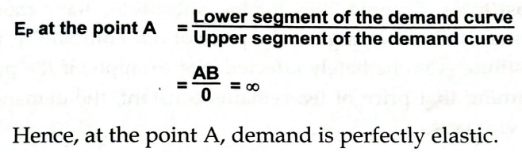
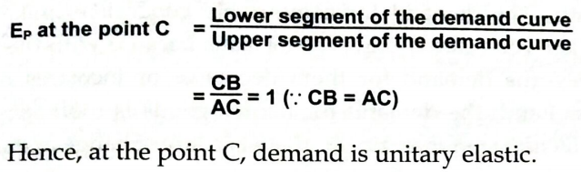
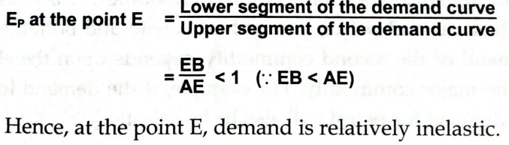
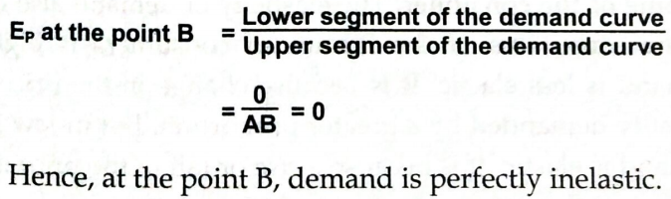
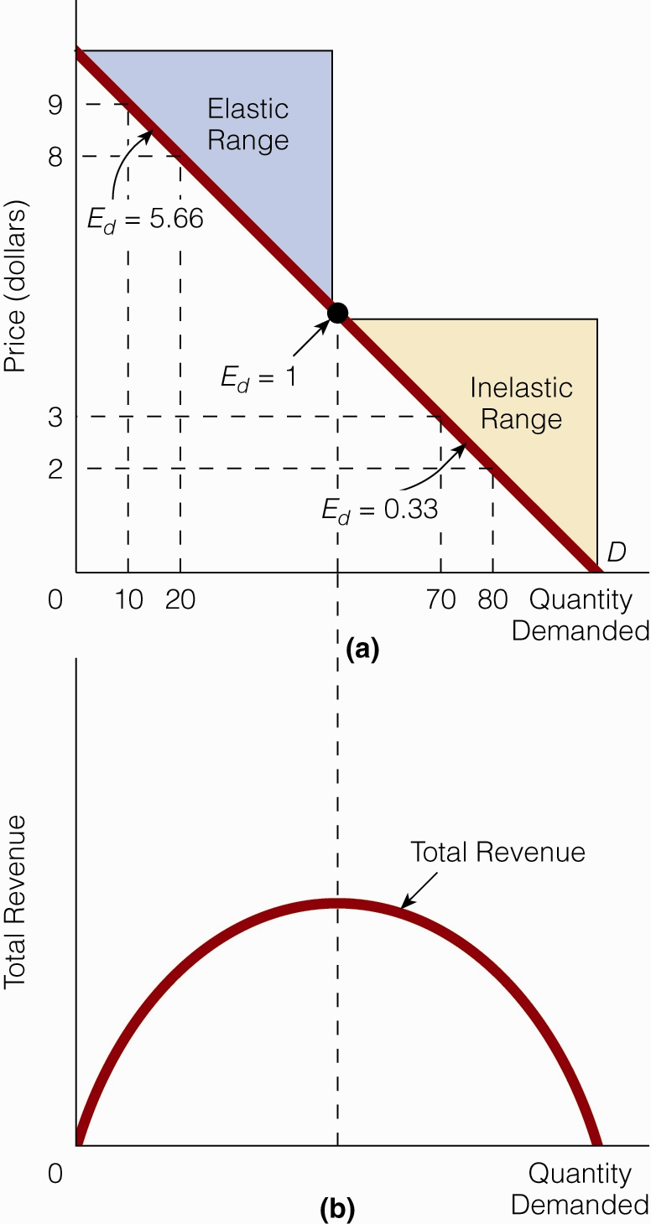
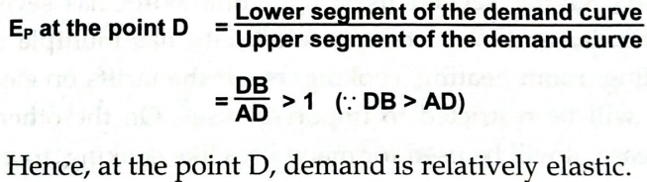
Can price level affect PED?
A(Ed=∞)
D(Ed>1)
C (Ed=1)
E (Ed<1)
B (Ed=0)

Slide 47

Price Elasticity of Demand & Firm’s Revenue
Will a price change increase revenue?
Elasticity | Revenue
Total revenue (TR) of a seller equals the price of a good times the quantity of the good sold (P x Q).
PED >1
Revenue
Increases
Revenue
Constant
PED =1
Revenue
Decreases
PED <1

Slide 48
What do you think the income elasticity of demand exhibits?

Slide 49
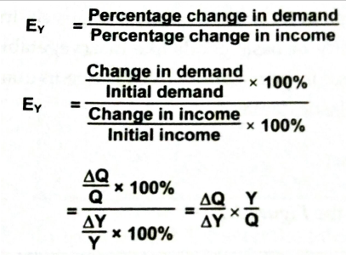
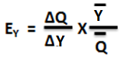
Income Elasticity of Demand
Measures the responsiveness in quantity demanded to changes in income.
With Arc Method
where,
E_{Y} = Coefficient of Elasticity of Demand
Q = initial demand
∆Q = change in demand
Y = initial income
∆ Y = change in income

Slide 50
What do you think is the implication of Income Elasticity of Demand to a manager?

Slide 51

Types of Income Elasticity of Demand
Positive Income Elasticity of Demand where E_{Y}>0
(i) Income Elasticity Greater Than Unity or E_{Y}>1
Luxury Goods
(ii) Income Elasticity Lesser Than Unity or E_{Y}<1
Normal Goods
(iii) Income Elasticity Equal to Unity or E_{Y}=1
Comfort Goods
b. Zero Income Elasticity of Demand where E_{Y} = 0
Neutral Goods (Salt, medicine)
c. Negative Income Elasticity of Demand where E_{Y} < 0
Inferior Goods (Coarse Rice Grain)

Slide 52
What do you think is the cross elasticity of demand exhibits?

Slide 53
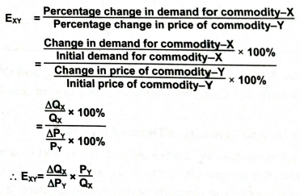
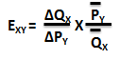
Cross Price Elasticity of Demand
Measures the responsiveness in quantity demanded of one good to changes in the price of another good.
With Arc Method
where,
E_{xY} = Coefficient of Elasticity of Demand
Q_{x} = initial demand price for good X
∆Q_{x} = change in demand for good X
P_{Y} = initial price for good Y
∆ P_{Y} = change in price for good Y

Slide 54
Types of Cross Price Elasticity of Demand
Positive Cross Elasticity of Demand where E_{XY}>0
Substitute Goods
b. Negative Cross Elasticity of Demand where E_{XY} < 0
Complement Goods
c. Zero Cross Elasticity of Demand where E_{XY} = 0
Independent Goods

Slide 55
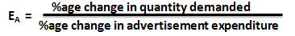
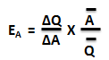
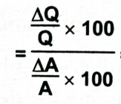
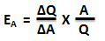
Advertisement Elasticity of Demand
Measures the responsiveness in quantity demanded to changes in advertisement.
With Arc Method
where,
E_{Y} = Coefficient of Elasticity of Demand
Q = initial demand
∆Q = change in demand
A = initial advertisement expenditure
∆ A = change in advertisement expenditure

Slide 56
Types of Advertisement Elasticity of Demand
(i) Advertisement Elasticity Greater Than Unity or E_{A}>1
(ii) Advertisement Elasticity Less Than Unity or E_{A}<1
(iii) Advertisement Elasticity Equal to Unity or E_{A}=1
In a sector where all competitors advertise at the same level, additional advertising may not have a direct effect on sales.
AEDs can vary widely based on brand.

Slide 57
How can Advertisement Elasticity of Demand be helpful to managers?
Useful for the manager to decide if the expenditure on
advertisement should be increased or decreased
Useful for the management to know the effect of
advertisement on sales revenue.
Useful in evaluating the effectiveness of various media
of advertisement

Slide 58

As you watch think how the consumers are making their choices.

Slide 59
On what basis the consumers make their choices????

Slide 60
Why do consumers buy the things they buy?
Price of the product
Income/Budget of the consumers
Satisfaction received from the commodity chosen

Slide 61
Satisfaction/Utility - Characteristics
Utility is subjective as it deals with the mental satisfaction of a man.
Utility is relative as it never remains the same and varies according to time and place.
Utility is not essentially useful.
Utility is independent of morality.

Slide 62
Making Choices
All desires of a consumer are not of equal importance or urgency.
Because resources are scarce, the problem of choice arises and that a consumer cannot satisfy all his desires.
So some desires take precedence over others. It is consumer’s scale of preference that determines his expenditure pattern.
Consumers maximize their well-being/satisfaction given their budget constraint and the price of the commodities.

Slide 63

Indifference Curve Analysis
Indifference curve: Contains combinations of two goods among which the consumer is indifferent
If two combinations of two goods yield the same level of utility, and are hence equally desirable, then they are on the same indifference curve.

Slide 64

Indifference Curve Analysis
Indifference curve reflects the level of preferences of a consumer.
Further the IC curve away from the origin the higher is the level of satisfaction.

Slide 65
A rational consumer would always like to be on the highest IC curve signifying highest level of satisfaction. But can he attain the highest possible satisfaction?

Slide 66
What factor decides if the consumer can attain the highest possible satisfaction?
Income of the consumer
Price of the Products

Slide 67
Budget Constraint
A rational consumer would always like to be on the highest IC curve signifying highest level of satisfaction. But it is governed by the level of income of the consumer and prices of goods in the market.
Budget line is a line that shows the different possible combinations of two goods X and Y, which a consumer can buy given his budget and the prices of good X and Y.
Anywhere on the budget line a consumer is spending his entire income either on Good X or on Good Y or the combination of both X and Y.
Budget = P_{X} Q_{X} + P_{Y} Q_{Y}

Slide 68
Attainment of Consumer’s Equilibrium
Suppose Rohit has Rs.4000 to spend per month on goods X and Y. Suppose the per unit prices of X and Y are Rs.800 and Rs.400 respectively. If he chooses to allocate the entire budget equally on two goods how will he make the optimum choice?
Suppose price of good X falls to Rs. 400 and Rohit decides to spend Rs.1600 on good X and Rs. 2400 on goods Y. Show the new equilibrium point for him.

Slide 69

QY
Suppose Rohit has Rs.4000 to spend per month on goods X and Y. Suppose the per unit prices of X and Y are Rs.800 and Rs.400 respectively. If he chooses to allocate the entire budget equally on two goods how will he make the optimum choice?
14
12
10
8
The equation of budget line is
B = P_{X} Q_{X} + P_{Y} Q_{Y}
If Rohit spends all his income on good X
Q_{X} = 4000/800 = 5 Units
If he spends all his income on good Y
Q_{Y} = 4000/400 = 10 Units
6
4
2
QX
2
4
6
8
10
12
14

Slide 70
QY
Suppose Rohit has Rs.4000 to spend per month on goods X and Y. Suppose the per unit prices of X and Y are Rs.800 and Rs.400 respectively. If he chooses to allocate the entire budget equally on two goods how will he make the optimum choice?
14
12
10
8
If Rohit allocates the budget equally on X and Y
Q_{X} = 2000/800 = 2.5 Units
Q_{Y} = 2000/400 = 5 Units
6
Equilibrium
E1
4
2
QX
2
4
6
8
10
12
14

Slide 71
QY
Suppose price of good X falls to Rs. 400 and Rohit decides to spend Rs.1600 on good X and Rs. 2400 on goods Y. Show the new equilibrium point for him.
14
12
10
8
6
E1
4
If price of X falls to Rs 400
Now Rohit can buy
Q_{X} = 4000/400 = 10 units
2
QX
2
4
6
8
10
12
14

Slide 72
QY
Suppose price of good X falls to Rs. 400 and Rohit decides to spend Rs.1600 on good X and Rs. 2400 on goods Y. Show the new equilibrium point for him.
14
PRICE EFFECT
12
10
8
With the fall in price of X, Rohit spends Rs.1600 on good X and Rs. 2400 on good Y, then
Q_{X} = 1600/400 = 4 Units
Q_{Y} = 2400/400 = 6 Units
6
E2
Equilibrium
E1
4
2
QX
2
4
6
8
10
12
14

Slide 73
Consumer’s Equilibrium
Suppose Rohit has Rs.4000 to spend per month on goods X and Y. Suppose the per unit prices of X and Y are Rs.800 and Rs.400 respectively. If he chooses to allocate the entire budget equally on two goods how will he make the optimum choice?
Suppose Rohit got a rise in his income and now he has Rs. 6000 to spend on X and Y with the price of X and Y being Rs. 400. Now Rohit decides to spend Rs.2000 on good X and Rs. 4000 on good Y. Show the new equilibrium point for him.

Slide 74
QY
Suppose Rohit got a rise in his income and now he has Rs. 6000 to spend on X and Y with the price of X and Y being Rs. 400. Now Rohit decides to spend Rs.2000 on good X and Rs. 4000 on good Y. Show the new equilibrium point for him.
14
12
10
8
When income of Rohit increases to Rs.6000
And Rohit spends all his income on good X
Q_{X} = 6000/400 = 15 Units
If he spends all his income on good Y
Q_{Y} = 6000/400 = 15 Units
6
E2
E1
4
2
QX
2
4
6
8
10
12
14

Slide 75
QY
Suppose Rohit got a rise in his income and now he has Rs. 6000 to spend on X and Y with the price of X and Y being Rs. 400. Now Rohit decides to spend Rs.2000 on good X and Rs. 4000 on good Y. Show the new equilibrium point for him.
14
INCOME EFFECT
12
E3
Equilibrium
10
8
6
E2
E1
With an increase in income Rohit spends Rs.2000 on good X and Rs. 4000 on good Y, then
Q_{X} = 2000/400 = 5 Units
Q_{Y} = 4000/400 = 10 Units
4
2
QX
2
4
6
8
10
12
14

Slide 76
Can a manager influence the customer's choices given the preferences and income of the consumers and the set price of the product?

Slide 77
Implication of Price Effect and Income Effect
Influence Consumers’ choices through pricing strategies that leads to a positive effect on the budget line of the consumers
Discount coupons (Income effect)
Sale - 50% off (Price effect)
Buy one Get One free Offers (Price effect)
Gift Cards (Income effect)

Slide 78
PRODUCTION THEORY
NEXT

